Slide 1
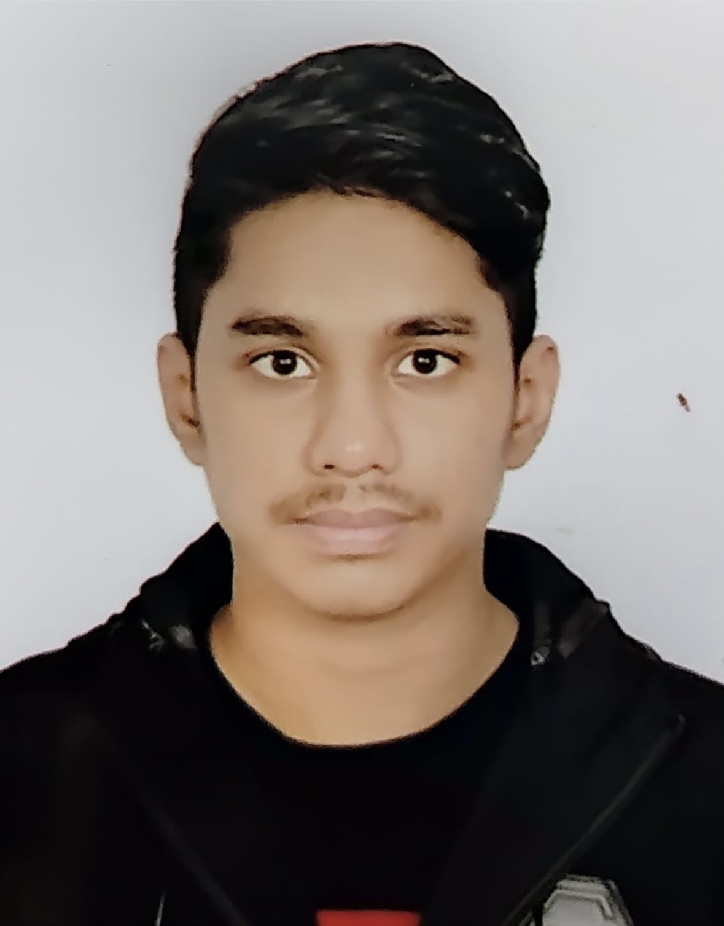
n
Profile :
Major in BBA in Human Resource Management at Independent University Bangladesh (IUB).
Minor in Marketing in BBA
Education
Idenpendent University Bangladesh ,
[BBA Major in Accounting Minor in Marketing]
Maple Leaf International School .
[From 2008 to 2022 : O Levels & A Levels ]
Work Experience
Tutoring
Student programming
Parbo camping
Experiential Skills
Digital Marketing
MS. Work
MS. Excel
MS. Power point
Language
Bangla
English
Hindi
References
Sheik Mohammad Fauzul Azim Marketing
Officer, pathao
Email: azim2705@gmail.com
97 Asad Avenue, Mohammadpur, Dhaka- 120
_________________________________________________________
Jaiyan Al hasan
Contact
Larmini Street Wari,
DHAKA, 1203
+8801994226989
jaiyanalhasan4@gmail.com

